Slide 1
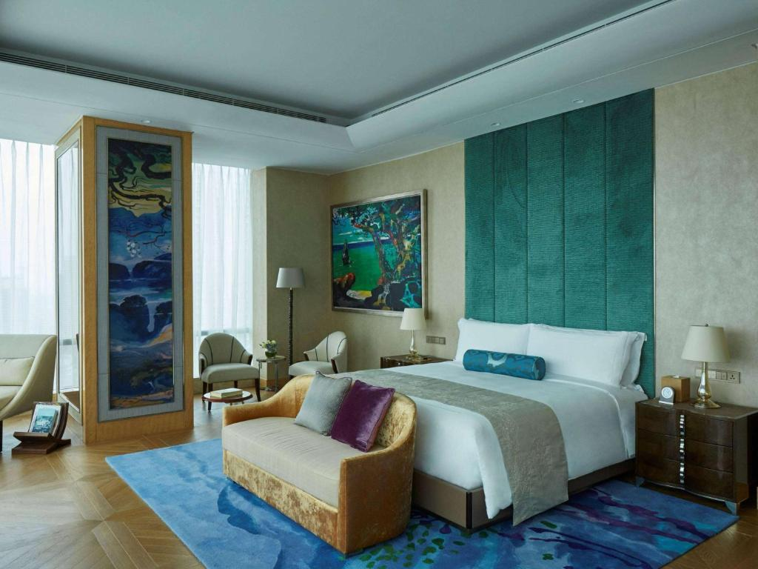
Staying at Venue - Hotel Raffles Jakarta
5 Stars
Prepared by :
For Peering Asia 6.0 attendees, we offer a special rate to book accommodations at the venue, Hotel Raffles Jakarta. ·Staying Period : 2024.11.05 ~ 2024.11.08 ·Room Type : Raffles Room / Raffles Garden View Room (60 sqm) ·Breakfast 1 Pax : Special Rate Offer Single Occupancy
IDR 2,750,000++/room/night
-Breakfast 2 Pax : Special Rate Offer Double Occupancy
IDR 3,010,000++/room/night * In order to reserve room accommodations, we encourage you to send an email to the authorized team as shown below:
• Nathanael Vidi - nathanael.vidi@raffles.com
• Reservation Team - bookus.jakarta@raffles.com
Website
https://www.raffles.com/jakarta/

Slide 2
Hotel Nearby Venue
Hotel | From Venue | Location
JW Marriott Hotel Jakarta https://www.marriott.com/en-us/hotels/jktjw-jw-marriott-hotel-jakarta/overview/ | 5 mins by car 9 mins by walk | https://maps.app.goo.gl/HQopZk4Vn2RJ1dDU7
The Ritz Carlton, Mega Kuningan Jakarta https://www.ritzcarlton.com/en/hotels/jktrz-the-ritz-carlton-jakarta-mega-kuningan/overview/ | 9 mins by car 12 mins by walk | https://maps.app.goo.gl/NFhXtC4QEminUajX6
Manhattan Hotel Jakarta https://hotel-manhattan.com/ | 8 mins by car 16 mins by walk | https://maps.app.goo.gl/e1iwqHM4BhJ2HwmC6
Ascott Kuningan, Jakarta https://ciputradevelopment.com/id/detail-properties/ciputra-world-jakarta-1-ascott-kuningan-jakarta-2/ | 3 mins by walk | https://maps.app.goo.gl/L3xRXZTkYqB6WDvk6
Artotel Mangkuluhur Jakarta https://artotelsuitesmangkuluhur.com-jakarta.com/id/ | 6 mins by car 20 mins by walk | https://maps.app.goo.gl/rNiF29E2f5cY8Han7
JS Luwansa Hotel Jakarta https://www.jsluwansa.com/ | 15 mins by car 20 mins by walk | https://maps.app.goo.gl/AZ9oc2D9finTiQwJ6

Slide 3
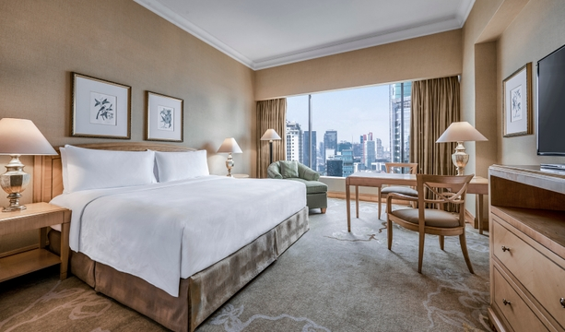
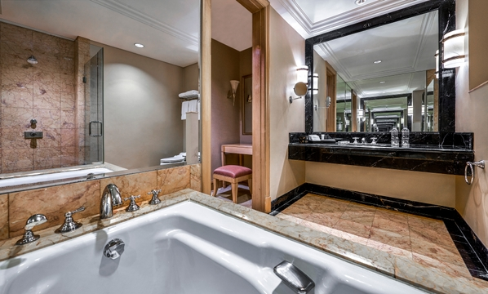
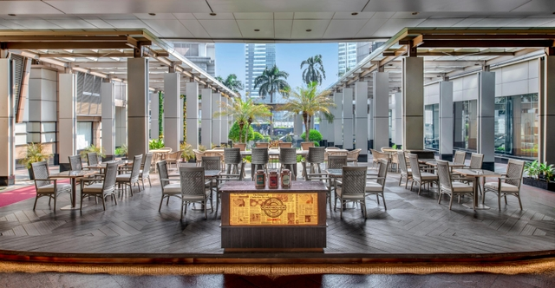
Hotel Nearby Venue - JW Marriott Kuningan
5 Stars
Prepared by :
JW Marriott Hotel Jakarta
Jl. DR. Ide Anak Agung Gde Agung No.1&2 Kav. E1.2, Kuningan, Kuningan Tim., Kecamatan Setiabudi, Kota Jakarta Selatan, Daerah Khusus Ibukota Jakarta 12950
Phone : +62-21-5798 8888
Website
https://www.marriott.com/en-us/hotels/jktjw-jw-marriott-hotel-jakarta/overview/?scid=f2ae0541-1279-4f24-b197-a979c79310b0
GMaps : https://maps.app.goo.gl/HQopZk4Vn2RJ1dDU7

Slide 4
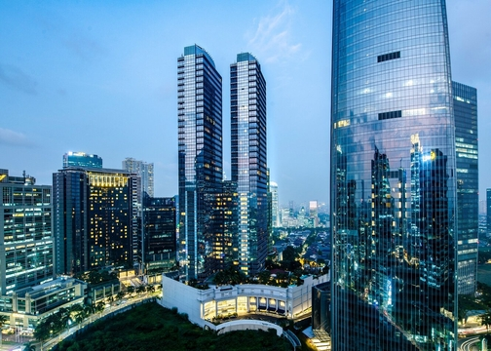
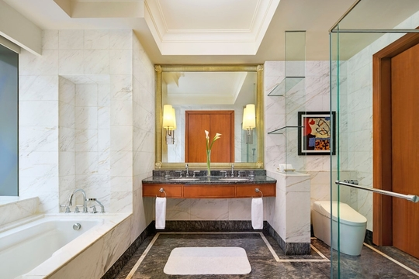
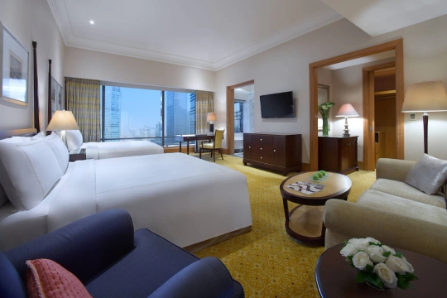
Hotel Nearby Venue - The Ritz Carlton, Mega Kuningan
5 Stars
Prepared by :
The Ritz Carlton, Mega Kuningan
Jakarta, Jl. DR. Ide Anak Agung Gde Agung No.1 Kav.E.1.1, Mega Kuningan, Daerah Khusus Ibukota Jakarta 12950
Phone : +62-21-2551 8888
Website
https://www.ritzcarlton.com/en/hotels/jktrz-the-ritz-carlton-jakarta-mega-kuningan/overview/?scid=f2ae0541-1279-4f24-b197-a979c79310b0

Slide 5
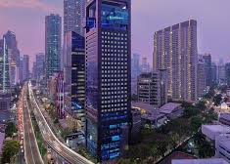
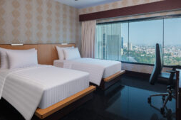
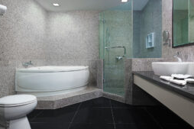
Hotel Nearby Venue - Manhattan Kuningan
4 Stars
Prepared by :
Manhattan Hotel, Karet Kuningan
Jl. Prof. Dr. Satrio Kav 19-24 Karet Kuningan, Jakarta Selatan 12940
Phone : +62-21-300 40888 - 529 61188
Website
https://hotel-manhattan.com/?utm_source=GoogleMyBusiness&utm_medium=GoogleMyBusiness&utm_campaign=GoogleMyBusiness

Slide 6
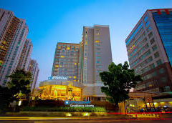
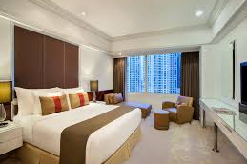
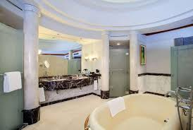
Hotel Nearby Venue - Ascott Kuningan, Jakarta
4+ Stars
Prepared by :
Ascott, Kuningan Jakarta
Ciputra World 1 Jalan Prof Dr Satrio Kav.3-5 Jakarta 12940
Phone : +62 21 3006 0288
Website
https://ciputradevelopment.com/id/detail-properties/ciputra-world-jakarta-1-ascott-kuningan-jakarta-2/

Slide 7
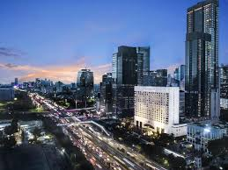
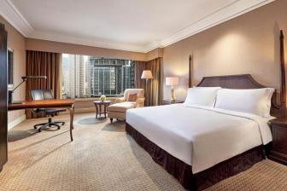
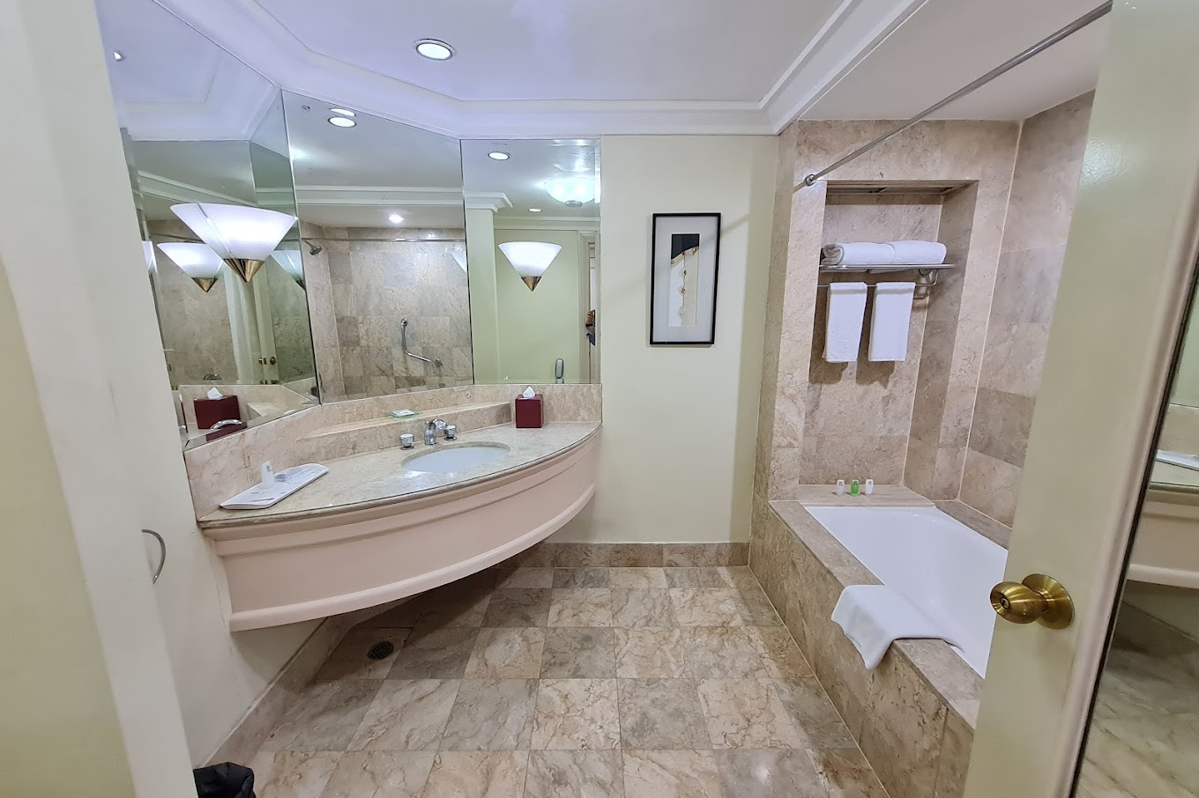
Hotel Nearby Venue - Artotel Suites Mangkuluhur
4 Stars
Prepared by :
Artotel Suites Mangkuluhur, Jakarta
Jl.Gatot Subroto Kav 2-3, Jakarta 12930
Phone : +62-21-526 8833
Website
https://artotelsuitesmangkuluhur.com-jakarta.com/id/

Slide 8
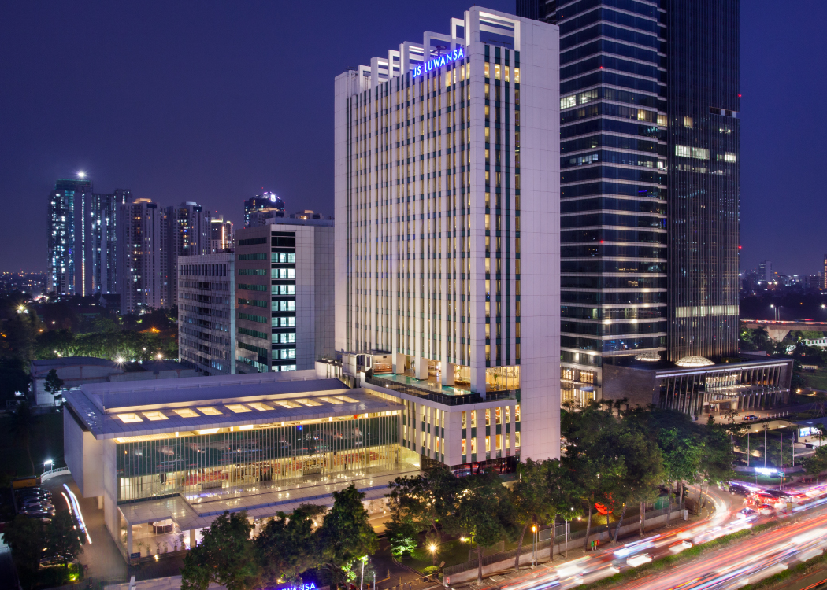
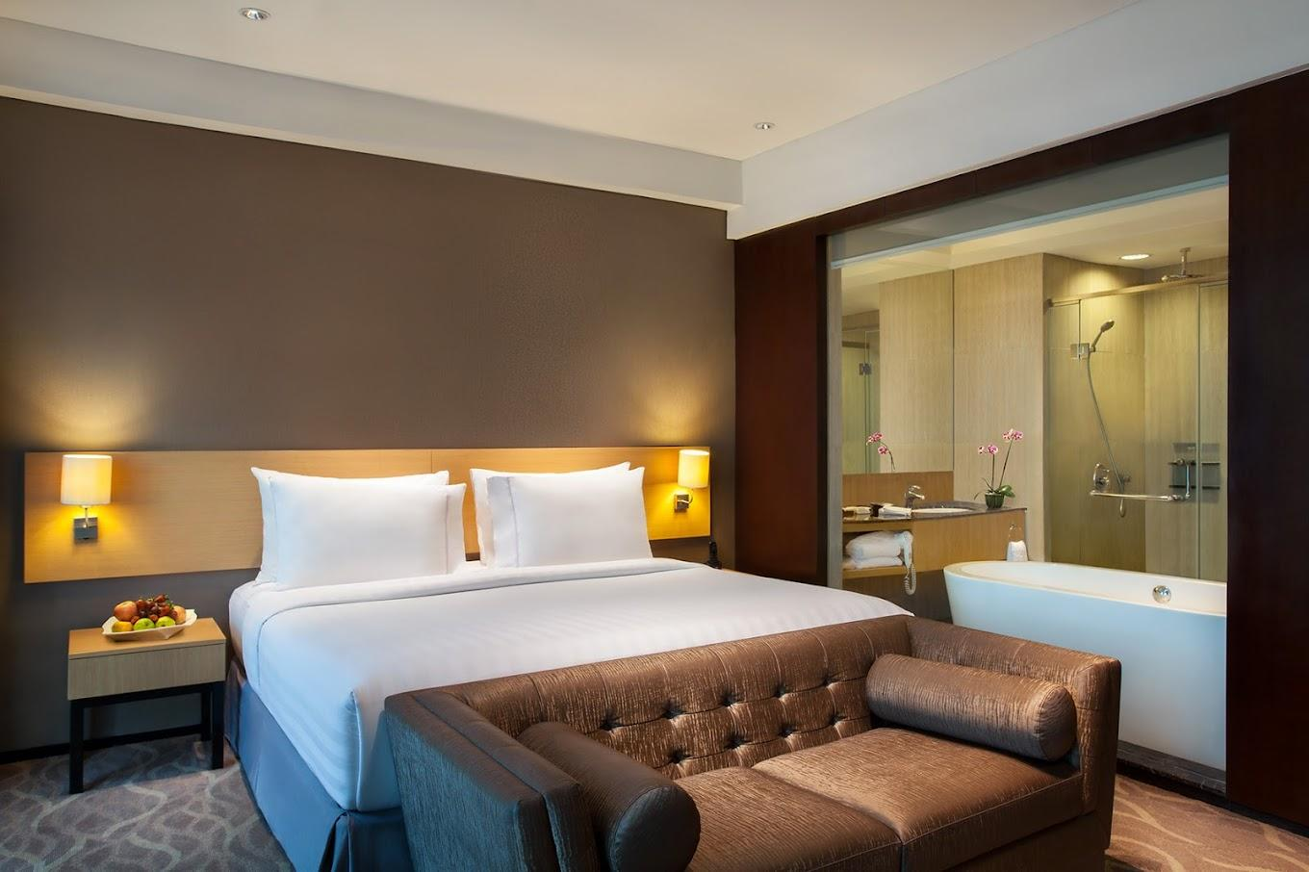
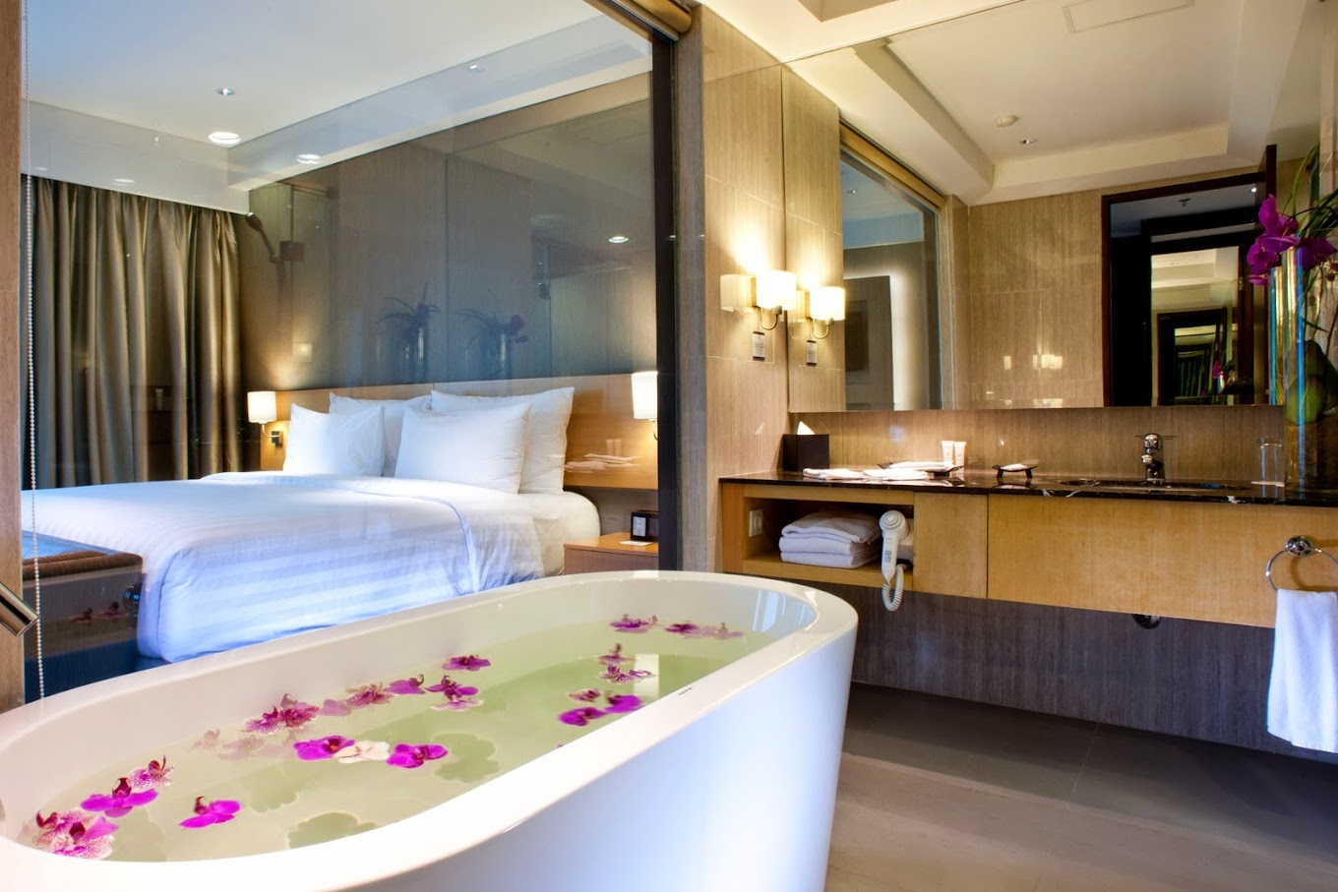
Hotel Nearby Venue - JS Luwangsa
4 Stars
Prepared by :
JS Luwangsa, Rasuna Said
Jl. HR Rasuna Said Kav C22, Karet Kuningan Jakarta 12940
Phone : +62-21-295 43030
Website
https://www.jsluwansa.com/

Slide 9
Hotel Nearby Entertainment & Experience
For Entertainment and Experience venue during your stay in Jakarta, you may check website :
https://www.indonesia.travel/gb/en/destinations/java/dki-jakarta.html .
https://jakarta-tourism.go.id/
Some of references that you can check :
Tourism Spots : https://jakarta-tourism.go.id/article/enjoy-taman-rekreasi
Golf Courts : https://www.leadingcourses.com/region/asia+indonesia+java+jakarta/top
Sport Spots : https://jakarta-tourism.go.id/article/enjoy-olahraga
Nearby Mall : https://jakarta-tourism.go.id/article/enjoy-belanja
Experience & Hang out Places : https://jakarta-tourism.go.id/article/bar-lounge, https://new.hwgroup.id/

Slide 10
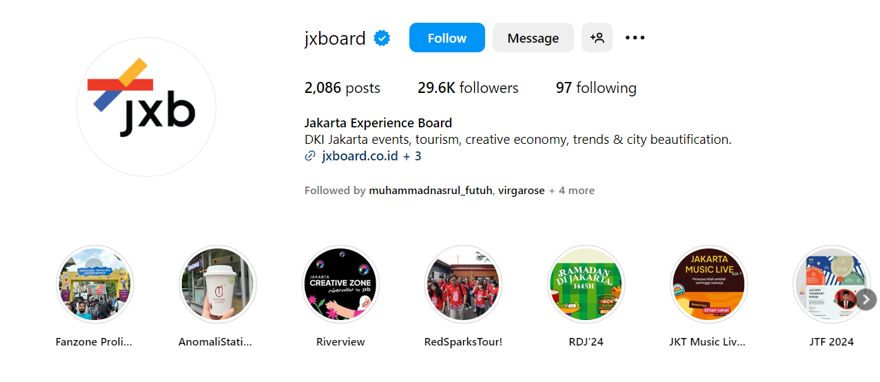
Tourism Spots
Prepared by :
Participants can explore @jkboard on Instagram to get information about tourism spots and updated events in Jakarta

Slide 11
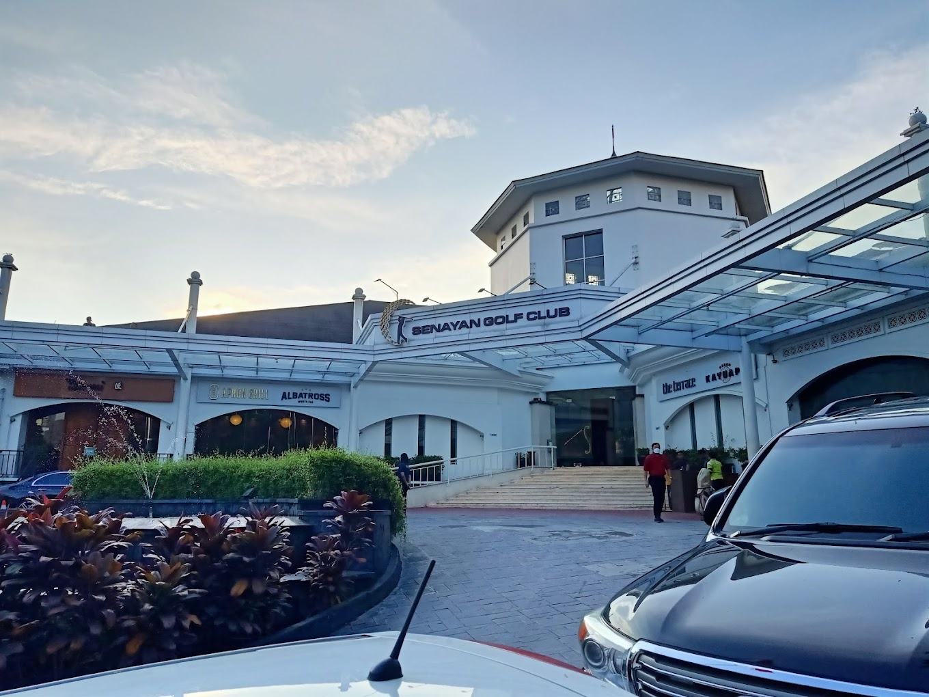
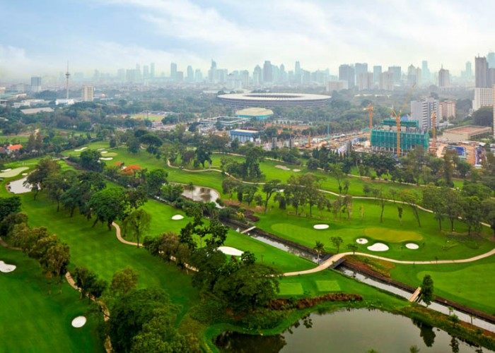
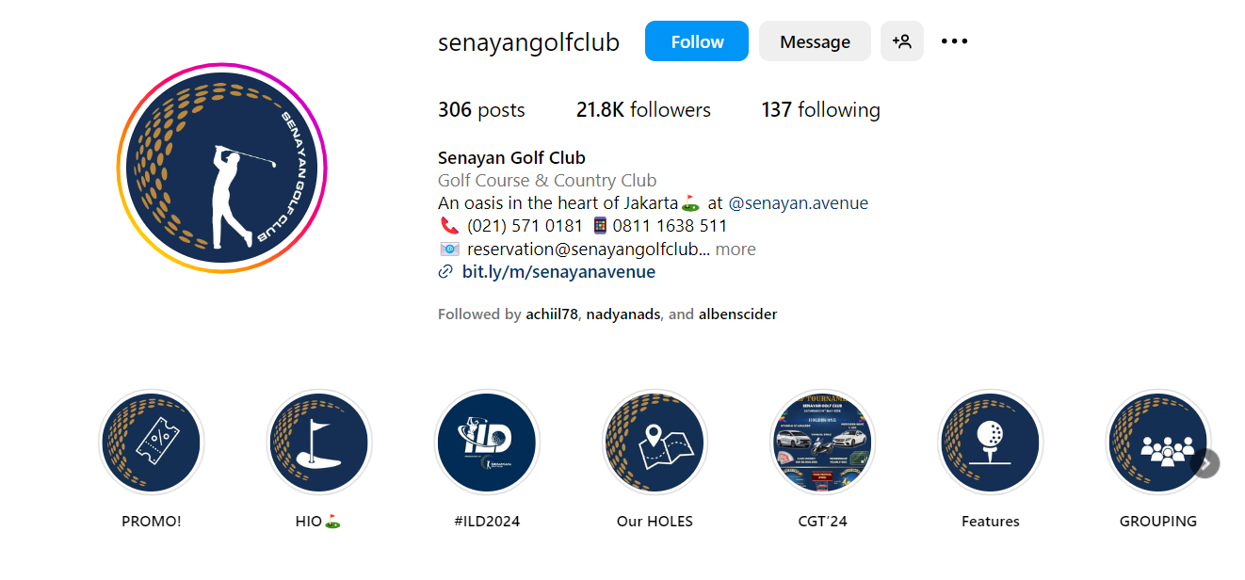
Golf Court Nearby - Senayan Golf Club
Prepared by :
Senayan Golf Club
Jl. Asia Afrika Pintu IX, RT.1/RW.3, Senayan, Kecamatan Tanah Abang, Kota Jakarta Pusat, Daerah Khusus Ibukota Jakarta 10270
Phone : +(021) 5710181
Instagram
@senayangolfclub

Slide 12
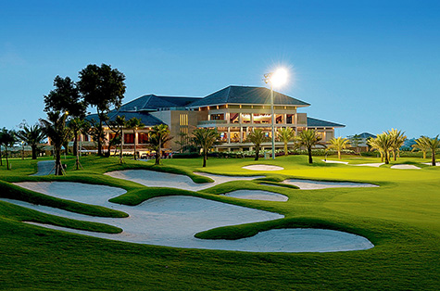
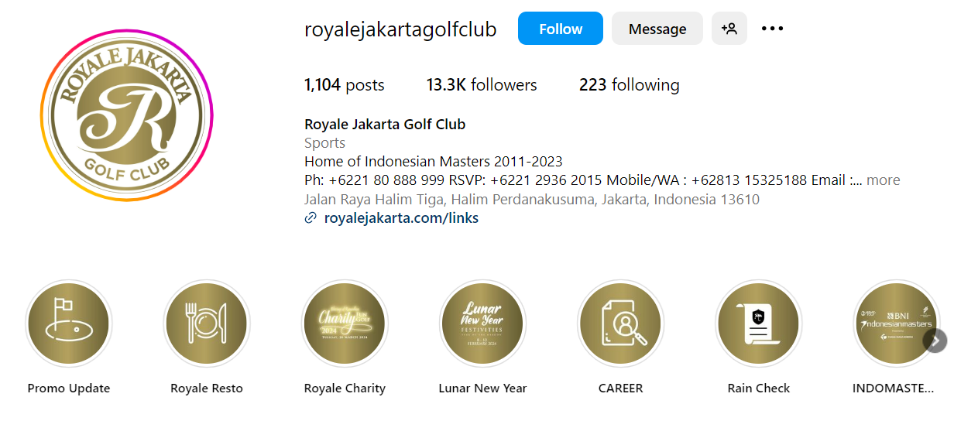
Golf Court Nearby - Royale Jakarta Golf Club
Prepared by :
Royale Jakarta Golf CLub
Jl. Raya Halim Tiga, Halim Perdana Kusumah, Kec. Makasar, Kota Jakarta Timur, Daerah Khusus Ibukota Jakarta 13610
Phone : (021) 80888999
Website
https://www.royalejakarta.com/
Instagram
@royalejakartagolfclub

Slide 13
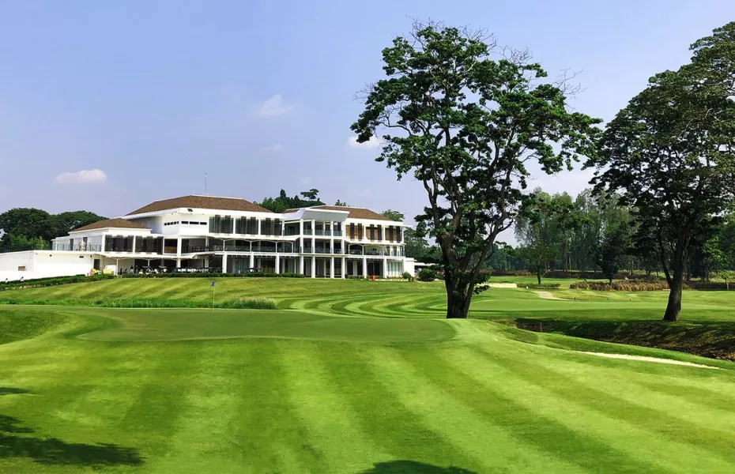
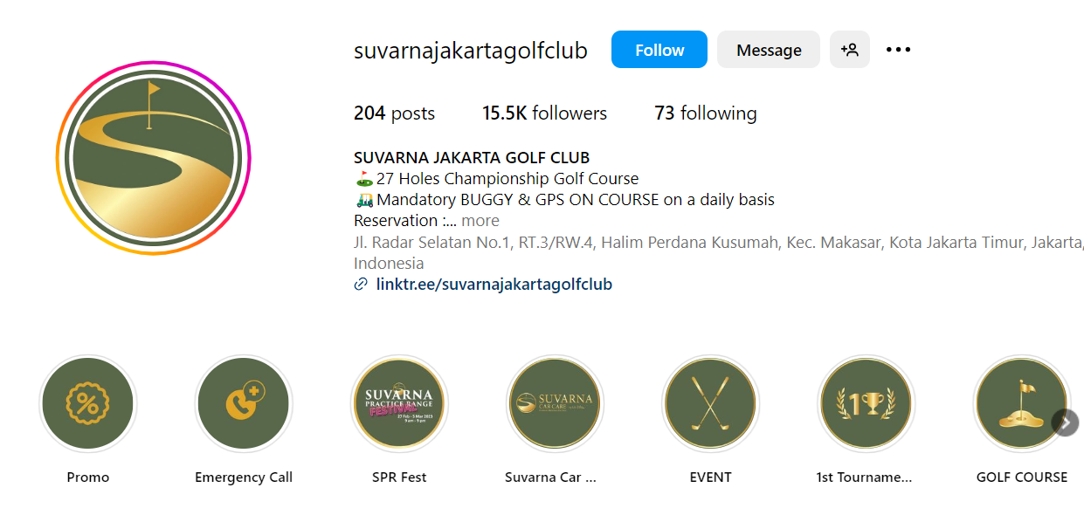
Golf Court Nearby - Suvarna Jakarta Golf Club
Prepared by :
Suvarna Jakarta Golf CLub
Jl. Radar Selatan No.1, RT.3/RW.4, Halim Perdana Kusumah, Kec. Makasar, Kota Jakarta Timur, Daerah Khusus Ibukota Jakarta 13610
Phone : +62-811-1586-873
Website
https://www.suvarnajakartagolfclub.com/
Instagram
@suvarnajakartagolfclub

Slide 14
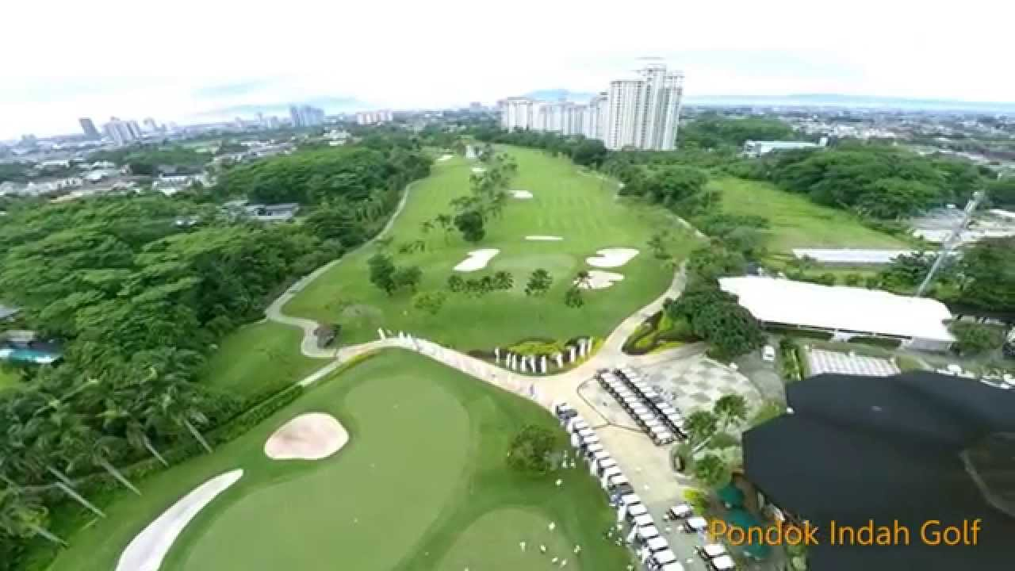
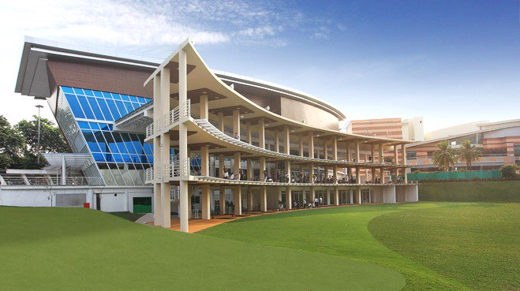
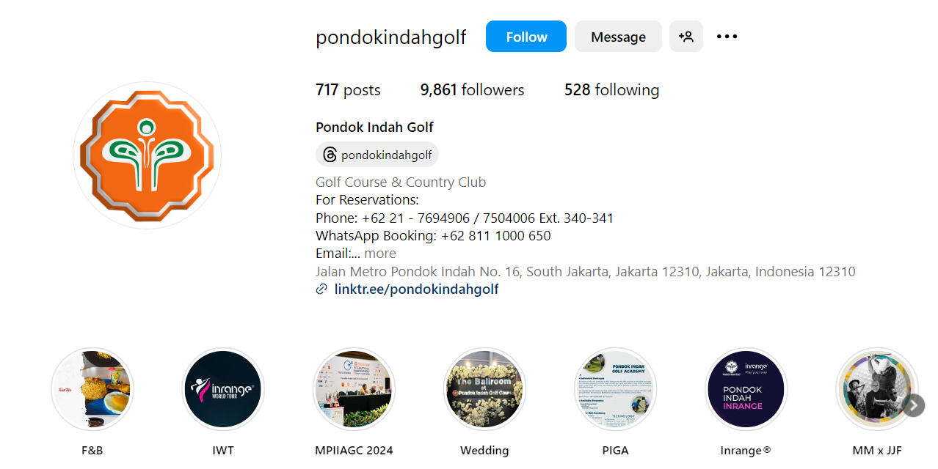
Golf Court Nearby - Pondok Indah Golf Club House
Prepared by :
Pondok Indah Golf Club House
Jl. Metro Pondok Indah No.Kav 1 1, RT.1/RW.16, Pd. Pinang, Kec. Kby. Lama, Kota Jakarta Selatan, Daerah Khusus Ibukota Jakarta 12310
Phone : +62-21-7698966
Website
http://www.golfpondokindah.com/
Instagram
@suvarnajakartagolfclub

Slide 15
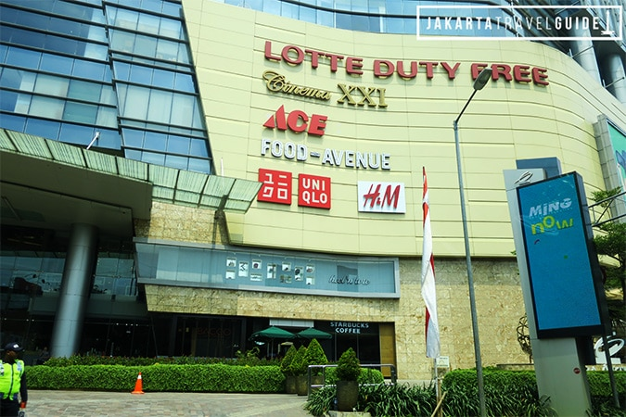
Mall Nearby - Lotte Shopping Avenue
Prepared by :
Lotte Shopping Mall
Kuningan, Jl. Prof. DR. Satrio Kav. 3-5, Karet Kuningan, Kecamatan Setiabudi, Daerah Khusus Ibukota Jakarta 12940
Phone : +62-2129888008
Website
https://www.lottemall.co.id/
Instagram
@lottemalljakarta

Slide 16
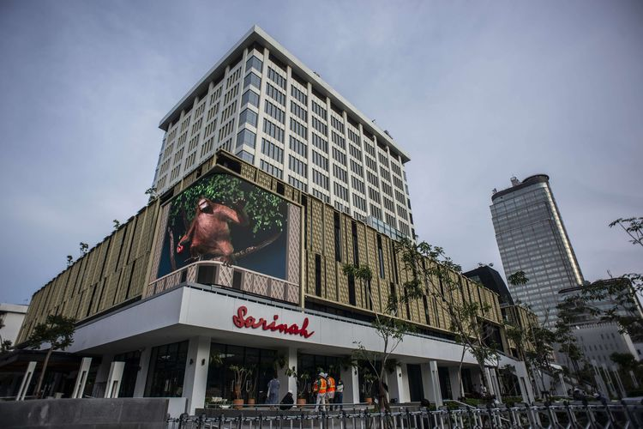
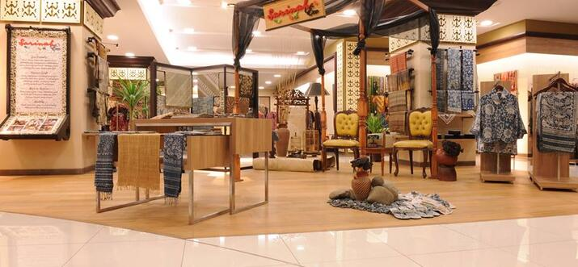
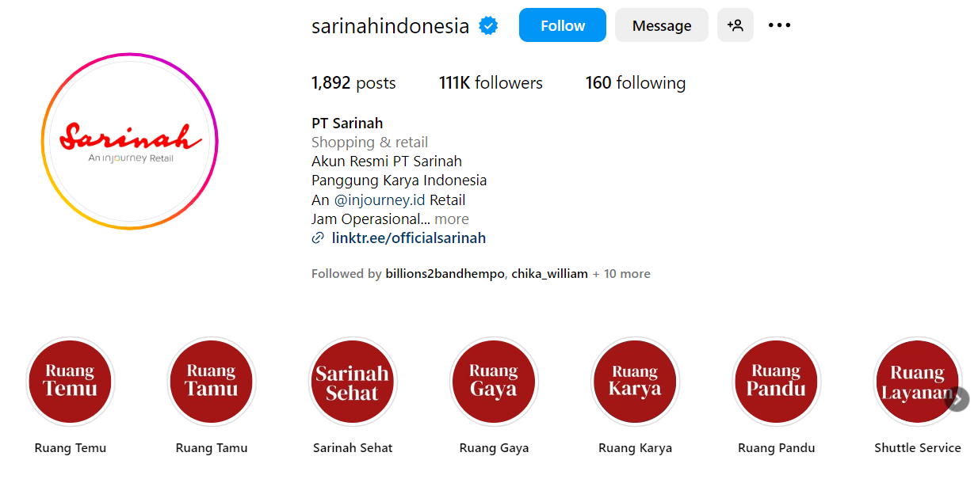
Mall Nearby - Sarinah
Prepared by :
Sarinah
Jl. M.H. Thamrin No.11, RT.8/RW.4, Gondangdia, Kec. Menteng, Kota Jakarta Pusat, Daerah Khusus Ibukota Jakarta 10350
Phone : +62-2131923008
Website
http://sarinah.co.id/
Instagram
@sarinahindonesia

Slide 17
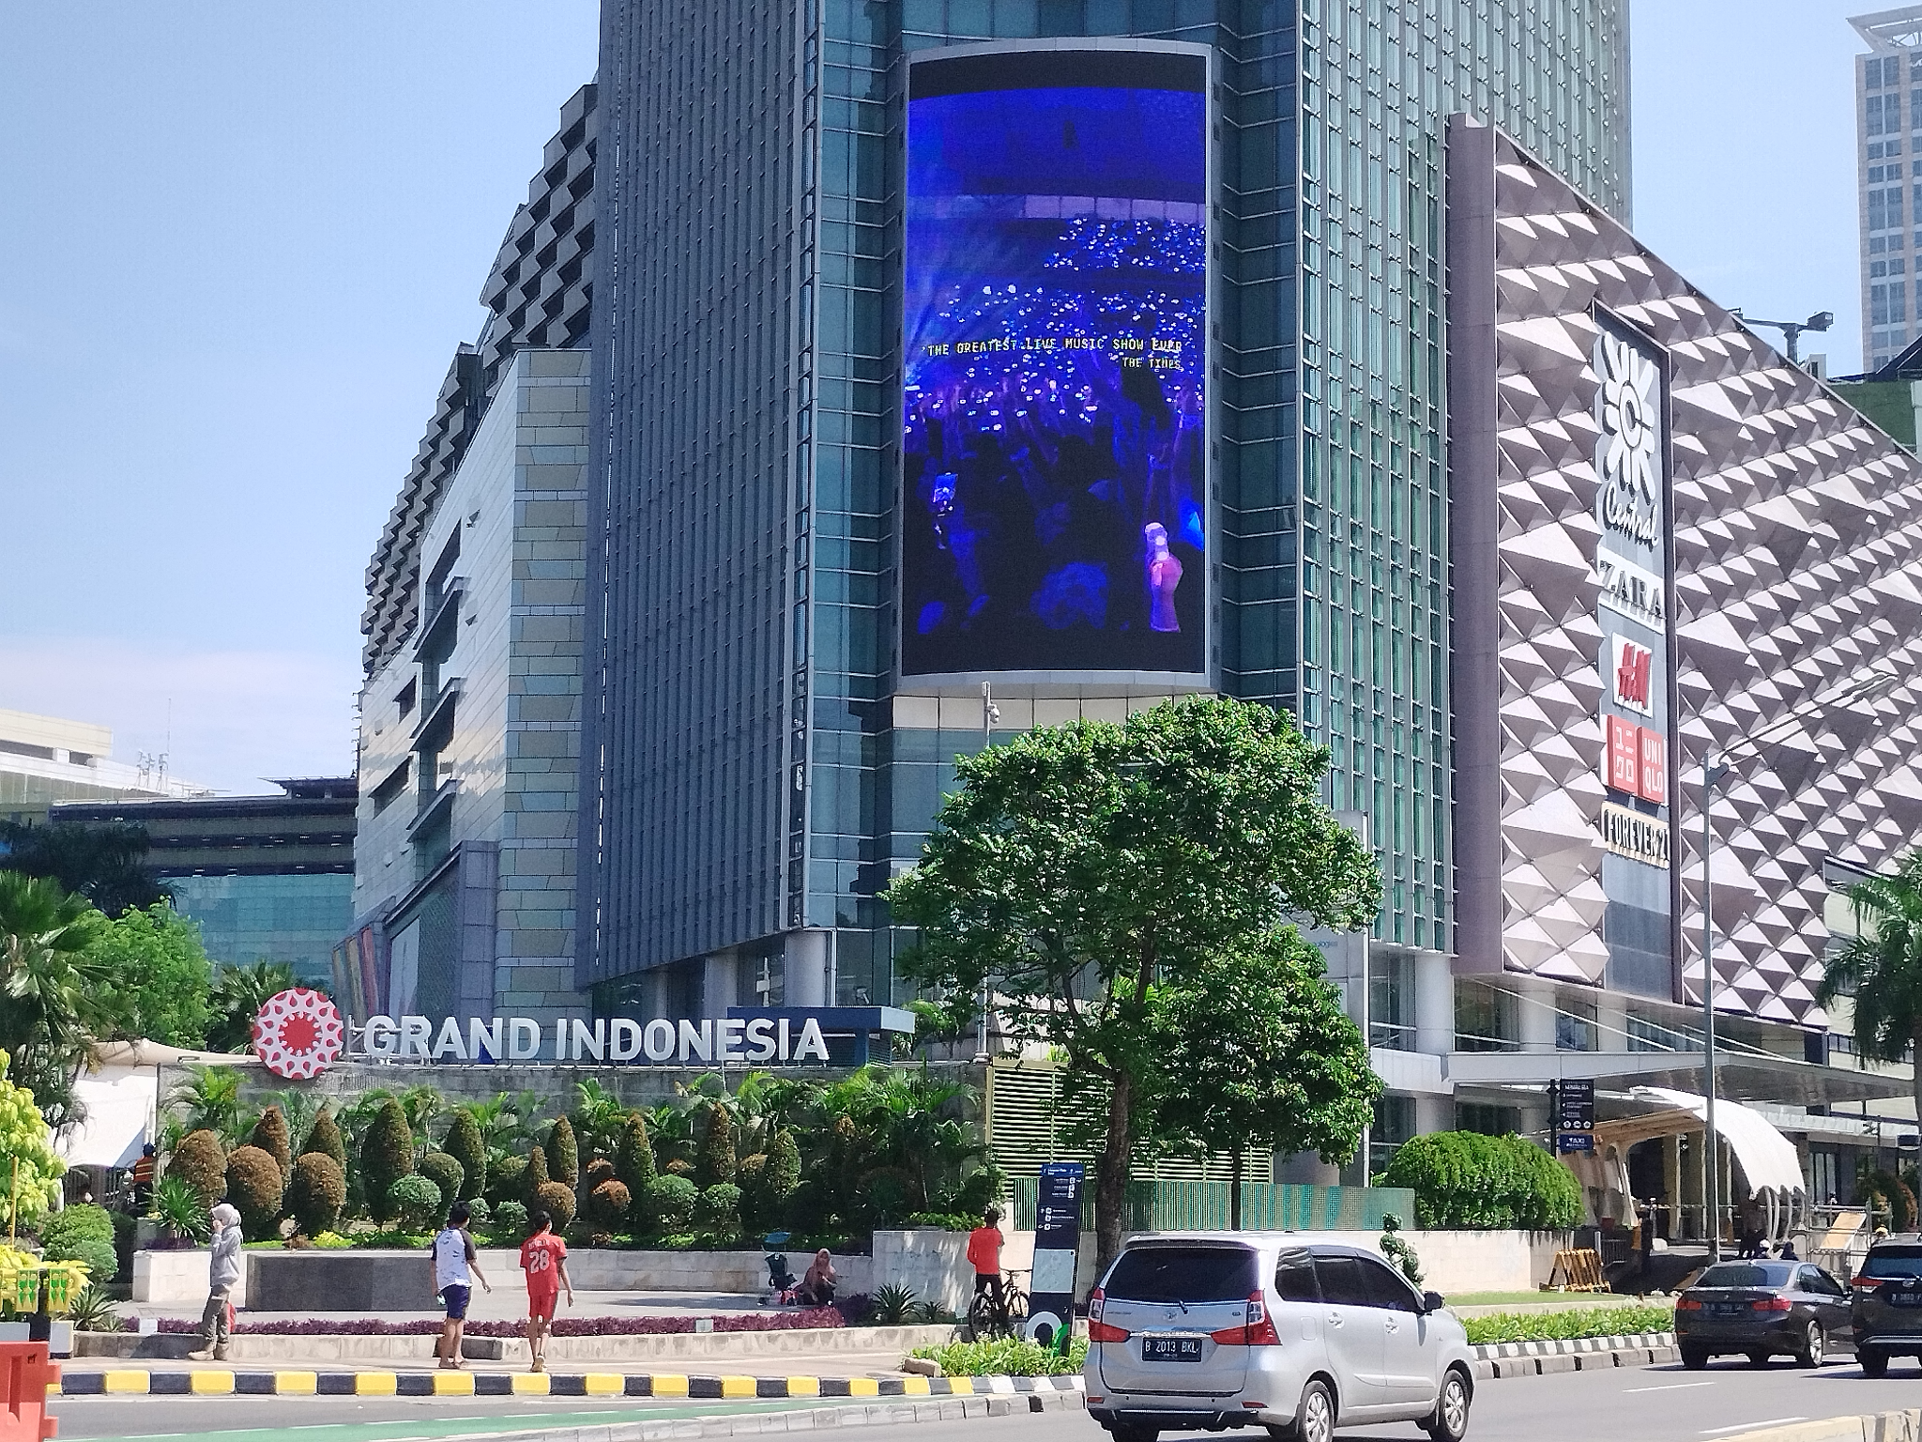
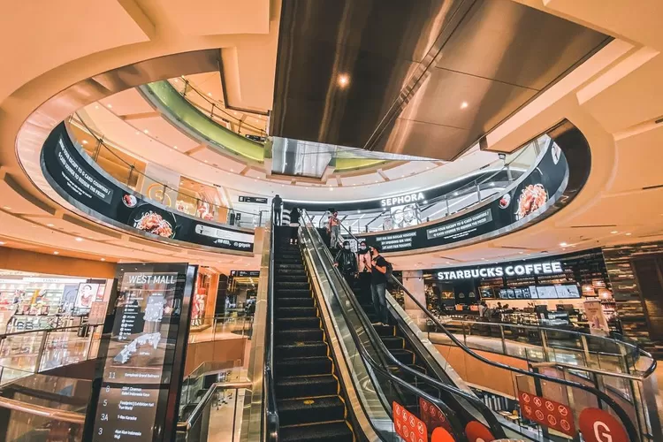
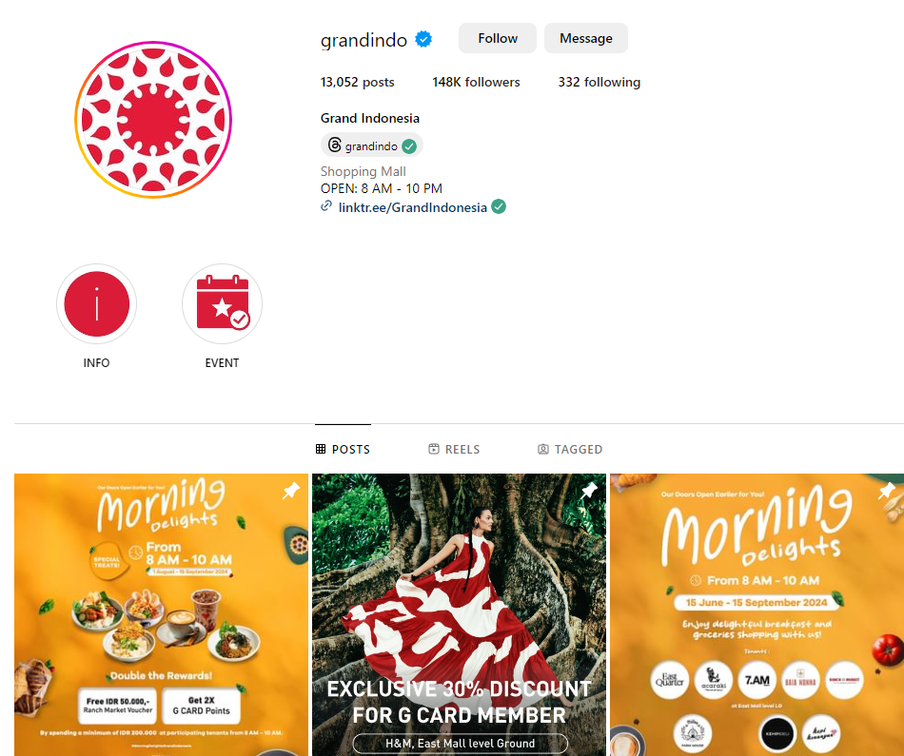
Mall Nearby - Grand Indonesia
Prepared by :
Grand Indonesia
Alamat: Jl. MH Thamrin No.1, Menteng, Kec. Menteng, Kota Jakarta Pusat, Daerah Khusus Ibukota Jakarta 10310
Website
https://www.grand-indonesia.com/
Instagram
@grandindo

Slide 18
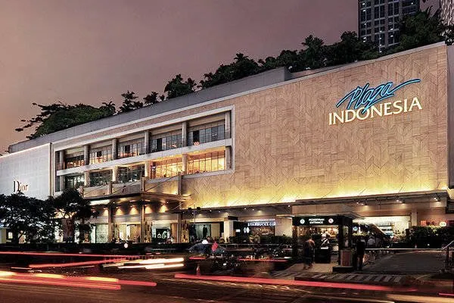
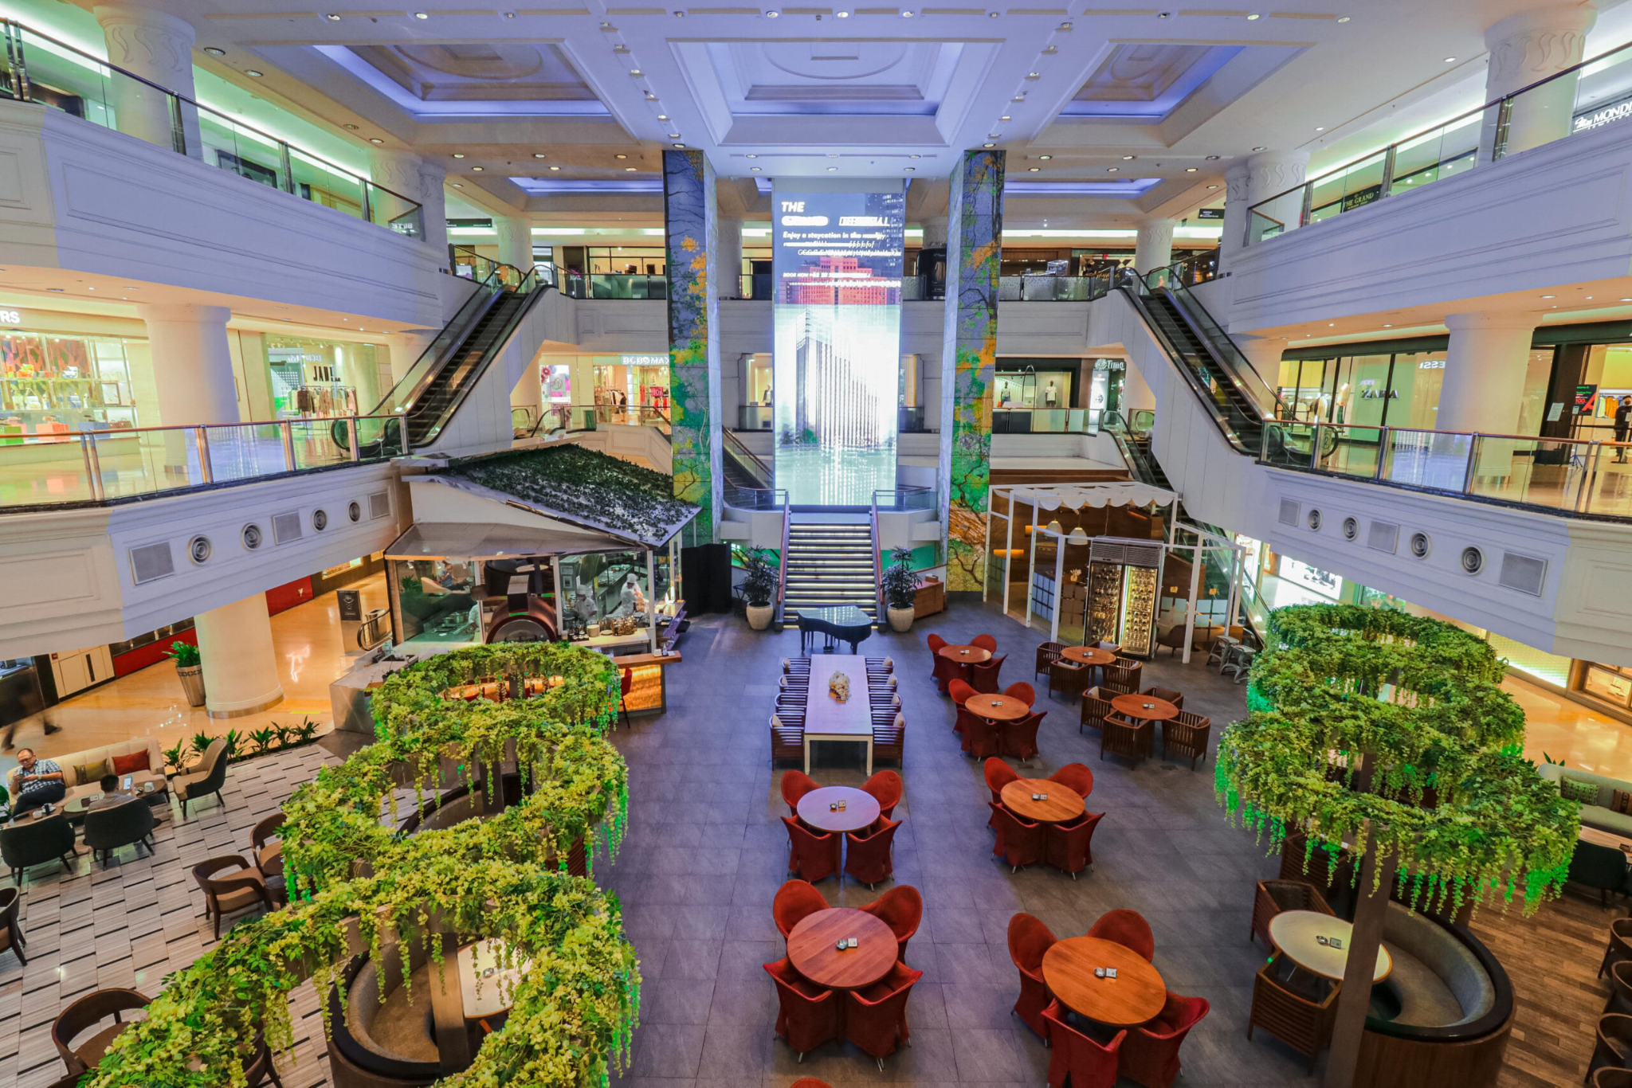
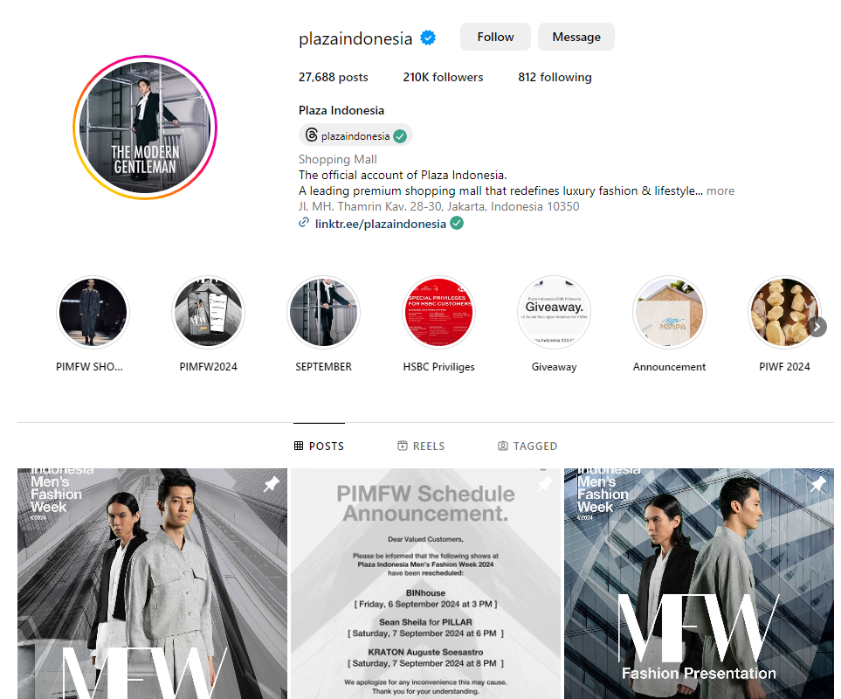
Mall Nearby - Plaza Indonesia
Prepared by :
Plaza Indonesia
Jl. M.H. Thamrin No.Kav.28-30, Gondangdia, Kec. Menteng, Kota Jakarta Pusat, Daerah Khusus Ibukota Jakarta 10350
Website
https://www.plazaindonesia.com/
Instagram
@plazaindonesia

